Slide 1
Introduction
to Probability

Slide 2
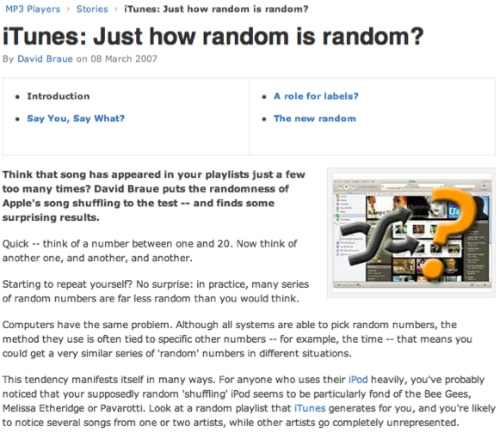
Random processes
A random process is a situation in which we know what outcomes could happen, but we don't know which particular outcome will happen.
Examples: coin tosses, die rolls, iTunes shuffle, whether the stock market goes up or down tomorrow, etc.
It can be helpful to model a process as random even if it is not truly random.
http://www.cnet.com.au/itunes-just-how-random-is-random-339274094.htm

Slide 3
Probability
There are several possible interpretations of probability but they (almost) completely agree on the mathematical rules probability must follow.
P(A) = Probability of event A
0 ≤ P(A) ≤ 1
Frequentist interpretation:
The probability of an outcome is the proportion of times the outcome would occur if we observed the random process an infinite number of times.
Bayesian interpretation:
A Bayesian interprets probability as a subjective degree of belief: For the same event, two separate people could have different viewpoints and so assign different probabilities.
Largely popularized by revolutionary advance in computational technology and methods during the last twenty years.

Slide 4
General Addition Rule
P(A or B) = P(A) + P(B) - P(A and B)
Note: For disjoint events P(A and B) = 0, so the above formula simplifies to P(A or B) = P(A) + P(B)

Slide 5
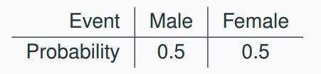
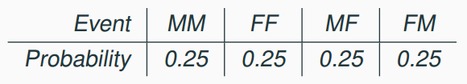
Probability distributions
A probability distribution lists all possible events and the probabilities with which they occur.
The probability distribution for the gender of one kid:
Rules for probability distributions:
1. The events listed must be disjoint
2. Each probability must be between 0 and 1
3. The probabilities must total 1
The probability distribution for the genders of two kids:

Slide 6
Sample space and complements
Sample space is the collection of all possible outcomes of a trial.
A couple has one kid, what is the sample space for the gender of this kid? S = {M, F}
A couple has two kids, what is the sample space for the gender of these kids?
S = {MM, FF, FM, MF}
Complementary events are two mutually exclusive events whose probabilities that add up to 1.
A couple has one kid. If we know that the kid is not a boy, what is gender of this kid? { M, F } Boy and girl are complementary outcomes.
A couple has two kids, if we know that they are not both girls, what are the possible gender combinations for these kids?
S = { MM, FF, FM, MF }

Slide 7
Independence
Two processes are independent if knowing the outcome of one provides no useful information about the outcome of the other.
Knowing that the coin landed on a head on the first toss does not provide any useful information for determining what the coin will land on in the second toss. >> Outcomes of two tosses of a coin are independent.
Knowing that the first card drawn from a deck is an ace does provide useful information for determining the probability of drawing an ace in the second draw. >> Outcomes of two draws from a deck of cards (without replacement) are dependent.

Slide 8
Checking for independence
If P(A occurs, given that B is true) = P(A | B) = P(A), then A and B are independent.
P(protects citizens) = 0.58
P(randomly selected NC resident says gun ownership protects citizens, given that the resident is white)
= P(protects citizens | White) = 0.67
P(protects citizens | Black) = 0.28
P(protects citizens | Hispanic) = 0.64
P(protects citizens) varies by race/ethnicity, therefore opinion on gun ownership and race ethnicity are most likely dependent.

Slide 9
Product rule for independent events
P(A and B) = P(A) x P(B)
Or more generally, P(A₁, and, … and A_{k}) = P(A₁) x … x P(A_{k})
You toss a coin twice, what is the probability of getting two tails in a row?
P(T on the first toss) x P(T on the second toss) = ½ x ½ =¼

Slide 10
Conditional
Probability

Slide 11
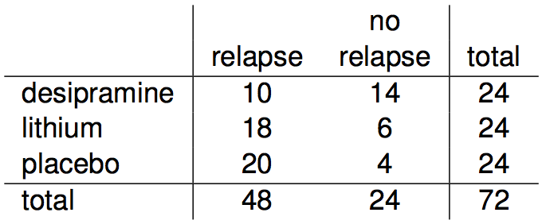
Relapse
Researchers randomly assigned 72 chronic users of cocaine into three groups: desipramine (antidepressant), lithium (standard treatment for cocaine) and placebo. Results of the study are summarized below.
http://www.oswego.edu/~srp/stats/2_way_tbl_1.htm

Slide 12
Marginal probability
What is the probability that a patient relapsed?

Slide 13
Marginal probability
What is the probability that a patient relapsed?
P(relapsed) = 48 / 72 ~ 0.67

Slide 14
Joint probability
What is the probability that a patient received the antidepressant (desipramine) and relapsed?

Slide 15
Joint probability
What is the probability that a patient received the antidepressant (desipramine) and relapsed?
P(relapsed and desipramine) = 10 / 72 ~ 0.14

Slide 16

Conditional probability
The conditional probability of the outcome of interest A given condition B is calculated as

Slide 17
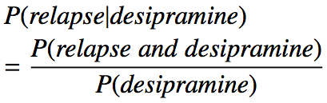
Conditional probability
The conditional probability of the outcome of interest A given condition B is calculated as

Slide 18

Conditional probability
The conditional probability of the outcome of interest A given condition B is calculated as

Slide 19

Conditional probability
The conditional probability of the outcome of interest A given condition B is calculated as

Slide 20

Conditional probability
The conditional probability of the outcome of interest A given condition B is calculated as

Slide 21
Conditional probability (cont.)
If we know that a patient received the antidepressant (desipramine), what is the probability that they relapsed?

Slide 22
Conditional probability (cont.)
If we know that a patient received the antidepressant (desipramine), what is the probability that they relapsed?
P(relapse | desipramine) = 10 / 24 ~ 0.42

Slide 23
Conditional probability (cont.)
If we know that a patient received the antidepressant (desipramine), what is the probability that they relapsed?
P(relapse | desipramine) = 10 / 24 ~ 0.42
P(relapse | lithium) = 18 / 24 ~ 0.75
P(relapse | placebo) = 20 / 24 ~ 0.83

Slide 24
Conditional probability (cont.)
If we know that a patient relapsed, what is the probability that they received the antidepressant (desipramine)?

Slide 25
Conditional probability (cont.)
If we know that a patient relapsed, what is the probability that they received the antidepressant (desipramine)?
P(desipramine | relapse) = 10 / 48 ~ 0.21

Slide 26
Conditional probability (cont.)
If we know that a patient relapsed, what is the probability that they received the antidepressant (desipramine)?
P(desipramine | relapse) = 10 / 48 ~ 0.21
P(lithium | relapse) = 18 / 48 ~ 0.38
P(placebo | relapse) = 20 / 48 ~ 0.42

Slide 27
General multiplication rule
Earlier we saw that if two events are independent, their joint probability is simply the product of their probabilities. If the events are not believed to be independent, the joint probability is calculated slightly differently.

Slide 28
General multiplication rule
Earlier we saw that if two events are independent, their joint probability is simply the product of their probabilities. If the events are not believed to be independent, the joint probability is calculated slightly differently.
If A and B represent two outcomes or events, then P(A and B) = P(A | B) x P(B) Note that this formula is simply the conditional probability formula, rearranged.

Slide 29

Independence and
conditional probabilities (cont.)
Generically, if P(A | B) = P(A) then the events A and B are said to be independent.
Conceptually: Giving B doesn’t tell us anything about A.
Mathematically: We know that if events A and B are independent, P(A and B) = P(A) x P(B). Then,

Slide 30
Bayes' Theorem
The conditional probability formula we have seen so far is a special case of the Bayes' Theorem, which is applicable even when events have more than just two outcomes.

Slide 31
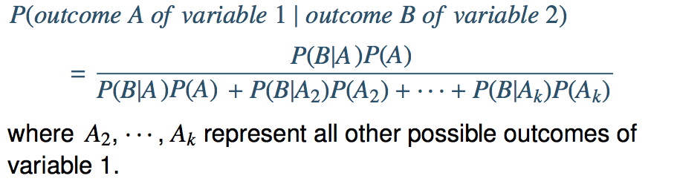
Bayes' Theorem
The conditional probability formula we have seen so far is a special case of the Bayes' Theorem, which is applicable even when events have more than just two outcomes.
Bayes’ Theorem

